Slide 1
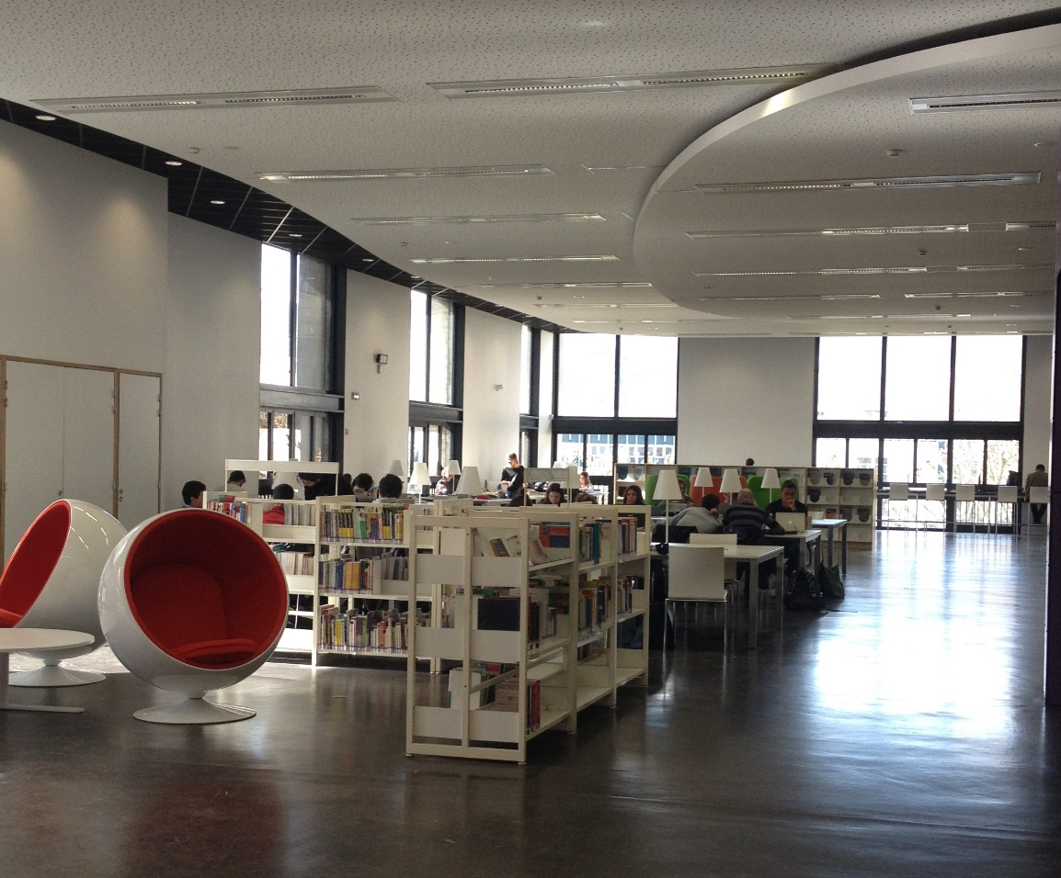
Manage document references and create a bibliography with Zotero
PhD module – A6
Tuesday, November 20, 2025
Myriam Dumarchez – Frédérique Simonot

Slide 2
Role of a bibliography
Why Zotero?
Using Zotero
Plan
Getting stuff into your library
Organizing your library
Taking notes
Generating bibliographies and citation
Backup
Notes:
We can’t show you everything there is to know about using Zotero. Instead, we’ll provide you with the knowledge you need to understand how to use this tool.
For further reading, see https://eformation.univ-grenoble-alpes.fr/course/section.php?id=23587

Slide 3

A bibliography… why?
To Rely on the authority of the cited researchers
To demonstrate scientific rigour
To show intellectual honesty
To build on previous research
To allow the corrector to identify the sources used
To Avoid plagiarism
To cite all sources

Slide 4

The bibliography is governed by a standard
ISO 960 International Standard
Translated into French (Afnor NF Z44-005)
Bibliographic formats and styles have been adapted since this standard.
Notes:
Standard : prescribe rules to respect to cite a reference.
This international standard specifies the bibliographic elements that need to be included in references to published documents, and the order in which these elements should be stated. (in Wikipedia)
Standard : 3 types of format, from which different styles are derived

Slide 5
3 bibliography formats
The name and date format
The numeric format
The running notes format
Notes:
The standard allows three citation methods.
The format depends on the subject area.

Slide 6
The name and date (eg APA)
The name of the author and the date (Rondeau, 2019) are found in the body of the text, and the bibliography is presented in alphabetical order by author (Chartier et al., 2007).
Bibliographie
Chartier, J.-P., Pedinielli, J.-L., & Barthélémy, S., Collab. (2007). Psychologie : Commencez avec les meilleurs professeurs. Eyrolles.
Rondeau, E.-L. (2019). Activités en pédagogie universitaire adressées aux bibliothécaires-formateurs québécois. Partnership: The Canadian Journal of Library and Information, 14(1).
Notes:
Name and date, in which the creator's name and the year of publication of the resource cited are given in the text:
For exemple, APA style (American Psychological Association).

Slide 7
The running notes
(eg Chicago 1/2)
In the running notes, I find the number of the note in the text¹ and a footnote at the end of the page, chapter or book. The bibliography is presented in alphabetical order by author².
¹ Rondeau, « Activités en pédagogie universitaire adressées aux bibliothécaires-formateurs québécois ».
² Chartier, Pedinielli, et Barthélémy, Psychologie [Texte imprimé].
Notes:
Running notes, in which numerals in the text – either in parentheses, brackets or superscript – refer to notes, which are numbered in order of their occurrence in the text:
For exemple, Chicago style.

Slide 8
The running notes
(eg Chicago 2/2)
Bibliographie
Chartier, Jean-Pierre, Jean-Louis Pedinielli, et Sophie Barthélémy Collab. Psychologie : commencez avec les meilleurs professeurs. Mention. Paris: Eyrolles, 2007.
Rondeau, Eve-Lyne. « Activités en pédagogie universitaire adressées aux bibliothécaires-formateurs québécois ». Partnership: The Canadian Journal of Library and Information 14, nº 1 (25 juillet 2019).

Slide 9
Numeric (eg ACS)
In the text, there is only a number. The bibliography is presented in numerical order according to the order of appearance of the references.
Bibliographie
(1) Rondeau, E.-L. Activités en pédagogie universitaire adressées aux bibliothécaires-formateurs québécois. Partnersh. Can. J. Libr. Inf. 2019, 14 (1).
(2) Chartier, J.-P.; Pedinielli, J.-L.; Barthélémy, S., Collab. Psychologie : Commencez Avec Les Meilleurs Professeurs; Mention; Eyrolles: Paris, 2007.
Notes:
Numeric, in which numerals in the text – either in parentheses, brackets or superscript – refer to resources in the order in which they are first cited:
For example, ACS style (American Chemical Society)

Slide 10
Bibliographic styles
3 formats are used as the basis for styles and adapted by scientific publishers.
Thousands of different styles are available and very easily editable in Zotero
Notes:
These three formats are used as the basis for styles, which are adapted by scientific publishers. Zotero offers thousands of different styles that can be easily edited.
A style adheres to the rules of its format. References in the text and bibliography must follow the same style.
It is impossible to use name-date system in the text and an order of the appearance of the references in the bibliography.
Scientific editors create their own style.
You should speak to your PhD supervisor to find out which style you need to use.
With Zotero, it doesn’t matter which style you use at the beginning of your work. You can easily change the style if it is incorrect.

Slide 11

Whatever style you choose:
Homogeneity
Completeness
Honesty
can help us to respect these different points.
Notes:
You need to ensure homogeneity throughout your document.
The references need to be complete, to enable all of them to be found.
Be honest : only cite the references you used.
For more information on plagiarism and citation, you can attend the training session « 180 minutes pour éviter le plagiat » (next session on 2026-01-26, see ADUM).
To help you manage your references and citations more efficiently, we recommend using reference management software such as Zotero.
Using such a tool will allow you to rationalise the management of your bibliographic references and to automate some cumbersome tasks, such as changing the bibliographic style of a document.

Slide 12


Why Zotero?
Bibliographic reference management software
Free
Open source
Well documented
Updated, evolves with user feedback
Notes:
OK, MyD
Recommended tools EPFL
Z
otero: Reference Management Software
Because Zotero is a powerful tool with a very user-friendly interface,
because it is free of charge and open source,
because it is compatible with many online resources.
Moreover, this reference manager benefits from a very active community, that always develops new features and could help you if needed.
Zotero is also compatible with most word processors, and with Firefox and Chrome.
Zotero est un logiciel de gestion des références bibliographiques, mais il n’est pas le seul (EndNote, Mendeley…), pas un outil de stockage des pdf.
Pour Latex Overleaf is an online platform for editing text in LaTeX without downloading any application. By registering to this platform with an account, you will not have access to a premium account… but ask your lab !
https://fr.overleaf.com/latex/templates/presentation-template-for-ufr-phitem-uga/cjjczpghpvrd
https://github.com/nicomagnet/template_UGA_manuscrit_ENG
https://www.overleaf.com/learn/latex/Bibliography_management_in_LaTeX
Premium = unlimited number of collaborative documents, connection with your Zotero account, etc.). T
he platform allows you to submit your documents directly to different publishers (IEEE Journal, Springer, etc.) or open archives repositories (arXiv, etc.) for possible publication.

Slide 13
Zotero Installation check
Version 7 (available since August 2024)
Installation procedure
Connectors
IT support
Who is already using Zotero? What needs? Hardship
Notes:
OK, MyD
FRED : Pour les doctorants je renverrai dans leur labo !!
Muse : lundi au vendredi 9h-17h
BSHM : Bureau B210 8h-19h jusqu’en mars, puis 18h avril, 17h mai et 16h juin (9h-17h juillet-août)

Slide 14

Zotero makes it possible to...
  collect
  manage
  annotate
  quote
  share bibliographic references.
Notes:
Interface divided into three columns, from the most general to the most specific.
Creating a collection (right click, new collection or sub-collection, option to rename, etc.)
Demonstration

Slide 15


Zotero: Collecting References
Via the browser connector
Via the magic wand
Via a pdf file already saved
Create a reference manually (cf Rational bibliographic)
Notes:
Connector : exemple dans Beluga.
It is important to reread and to modify your references if necessary (see capital letters at the beginning of sentences):
Zotero works with the metadata present on websites.
If this metadata is incorrect, Zotero will not be able to generate a correct reference.
VERIFY your data.
ISBN 978-2-01-700950-4 Espace-mot

Slide 16
Reading a reference list: easy or not?
Understand how a bibliographic reference works
Be attentive to the moment of recovery
You must correct mistakes as you go
Shall we test ourselves?

Slide 17
Zotero: organize your references
Create collections and sub-collections
Move, delete references (from your collection / your library)
Search for references into your collection
Remove duplicates
Annotate your references / Use markers
Retracted items
Notes:
References can be moved, deleted or copied very easily.

Slide 18
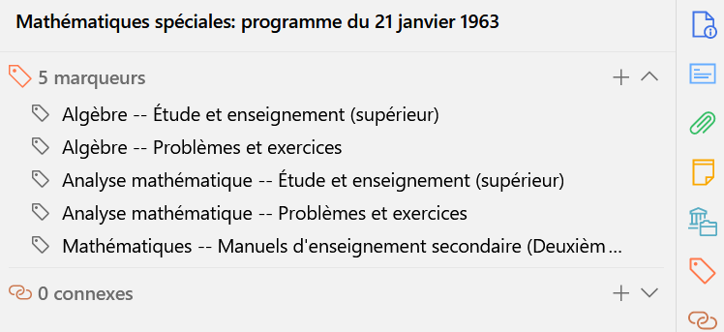
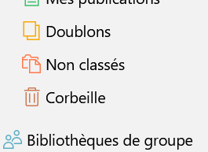
Zotero: organize your references
Add keywords (markers)
Duplicate items
Notes:
Possible de déplacer, supprimer ou copier des références très facilement

Slide 19
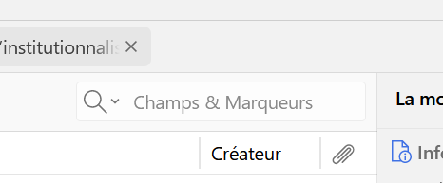
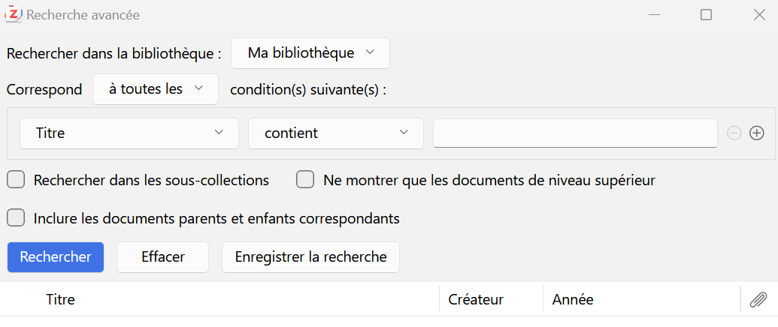
Zotero: find your references

Slide 20
Zotero: the PDF reader
Actively read pdfs
Highlighting/underlining a passage (different colours)
Select an image, a graph...
Add a descriptive note
Draw or write in PDF
Retrieve your notes
Use your notes when writing your thesis
Notes:
https://tutos.bu.univ-rennes2.fr/c.php?g=686448&p=5080790
https://www.youtube.com/watch?v=eOb263dg-yQ&list=PLcsW2G3QhlZWACDM1_2_PK3N6QcCBvH92&index=9
https://www.youtube.com/watch?v=UkMe-WBYKhM

Slide 21
Zotero: Creating a Bibliography
Create a static bibliography
Create a dynamic bibliography in your manuscript
As you write: add references
At the end of the writing, click "Add a bibliography"
Choice of style, which can be changed according to needs.

Slide 22
"Zotero and AI"
  Citing AI when using it is proof of your scientific integrity
  However, these guidelines are vague, sometimes non-existent
  As of May 2023, only the APA, Chicago, and MLA styles have published guidelines for citing generative AI.
  Without specific guidelines, the software citation mode can be used
Notes:
Cf Lacroix, D. (s. d.). Subject Guides : IA générative : utilisation: Comment citer l’IA générative. Consulté 8 janvier 2025, à l’adresse https://guides.library.ualberta.ca/c.php?g=737964&p=5327922

Slide 23
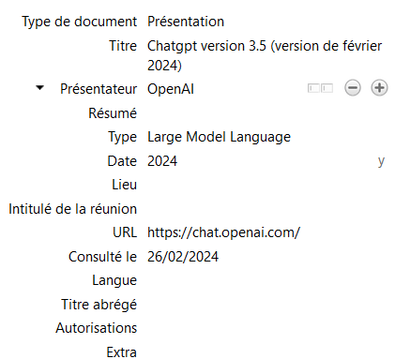
IA at APA Style
Quote in the text:
(Author/creator of the AI model, year of version used)
(OpenAI, 2024)
Zotero : utiliser le type de document « presentation »
In the final bibliography:
Author/creator of the AI model. (Year the prompt was generated). Model Name (Model Version Date) [Model Type or Description]. The web address of the template.
OpenAI. (2024). Chatgpt version 3.5 (version de février 2024) [Large Model Language]. https://chat.openai.com/
Notes:
Article du blog APA : https://apastyle.apa.org/blog/how-to-cite-chatgpt

Slide 24

IA at Chicago Style
Footnote: Author, prompt description, date text was generated, publisher. (Omit prompt if you describe it in your text)
ChatGPT 3.5, réponse à "Explain how to make pizza dough from common household ingredients", OpenAI, 26 février 2024
Citation in text (author-date): Author/creator of the AI model, year of version used
(ChatGPT 3.5, February 26, 2024)
But not in Bibliography!
« But don’t cite ChatGPT in a bibliography or reference list unless you provide a publicly available link (…) Though OpenAI assigns unique URLs to conversations generated from your prompts, those can’t be used by others to access the same content (they require your login credentials) »
« To sum things up, you must credit ChatGPT when you reproduce its words within your own work, but unless you include a publicly available URL (…) not in a bibliography or reference list. »
Notes:
https://www.chicagomanualofstyle.org/qanda/data/faq/topics/Documentation/faq0422.html

Slide 25
IA : Some tips
No instructions?
Keep your prompts as bibliographic references: name and version of the template, prompt or description of the prompt, date the prompt was generated, author/creator of the AI template, web address of the template.
Indicate in your work the uses of generative AI: where, for what... in the body of your text, in parenthesis or in a footnote.
You will be able to reuse the information you have stored.
Check the best practice expected by the person who will evaluate your work:
For your thesis -> Your thesis supervisor
For a publication -> The publisher's instructions for authors.
When writing, check for any changes to the standard you are using.

Slide 26
Your account at zotero.org
You can use SYNCING
  to save what you add ‘online’ or the work you have done on your computer
  You can create a group (visible or invisible) and display a collaborative library (visible or invisible)
  By default, Zotero will merge your local Zotero library with your library on zotero.org: any changes you make in one place will be applied to the other !
See ‘Settings’:
  “Zotero's sync functionality allows you to access your Zotero library on any computer with internet access. Zotero syncing has two parts: data syncing and file syncing.”

Slide 27
Protocole WebDAV
he
An alternative to syncing files using Zotero's storage is to use ZotMoov
Another is based on Webdav protocol ! Research institution provide WebDAV storage.
  You need
“/zotero” part at the end of the WebDAV URL is added automatically by Zotero and should not be included when entering the WebDAV URL into Zotero preferences.
Notes:
WebDAV
WebDAV is a standard protocol for transferring files over the web, and it can be used to sync files in your personal library.
(Group libraries cannot use WebDAV.)
Your employer or research institution may be able to provide WebDAV storage.
Once you have your WebDAV account info, enter the URL provided by the service, your username, and your password in the Sync preferences tab. Be sure to select 'http' or 'https' as appropriate — if you're not sure, try 'https' first. After entering the information, click “Verify Server”. If Zotero successfully verifies the WebDAV account, you're all set to use file syncing via WebDAV.
Zotero file sync should work with any correctly functioning WebDAV server. Zotero developers cannot provide support for third-party WebDAV servers.

Slide 28
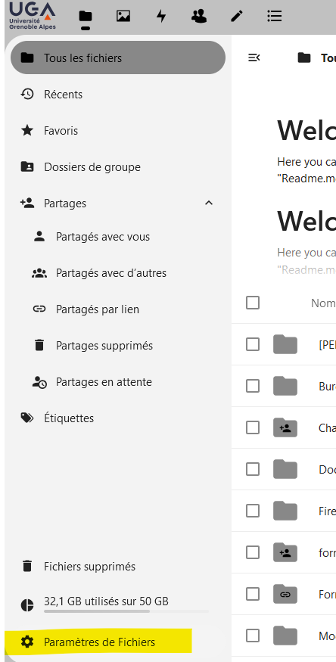
1/ Webdav link from UGA
(from the cloud)
→ File parameters
Notes:
(Web-based Distributed Authoring and Versioning : un serveur de fichier qui communique avec d’autres serveurs…

Slide 29
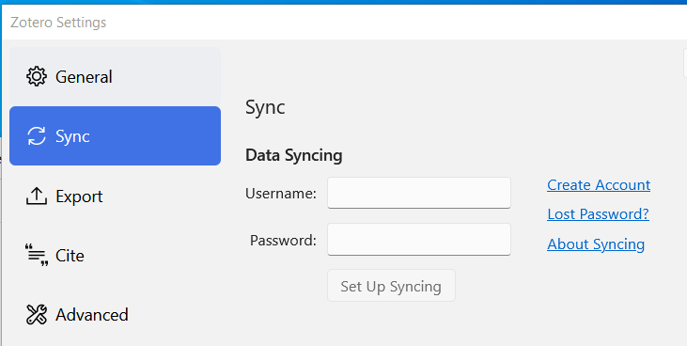
2/SYNCING
Select webdav, Insert the cloud link, Use your agalan ID and password, Test the connexion.
Sometimes you need to create first a folder named ZOTERO
You can save the PDF files to the cloud.
Notes:
Sélectionner WebDav,
coller le lien du cloud, indiquer ses identifiants agalan et cliquer sur "Tester la connexion au serveur".
Il est parfois nécessaire de créer un dossier Zotero dans le cloud pour que cela fonctionne.

Slide 30
Any questions ?
Recommandation : Verify the quality of the references (to correct) and think about backup !
Workshop at the library https://bibliotheques.univ-grenoble-alpes.fr/se-former/les-ateliers-de-la-bu/zotero-459444.kjsp?RH=15497069675
Tutorials
  https://guides.lib.berkeley.edu/c.php?g=4472&p=15929
  https://eformation.univ-grenoble-alpes.fr/course/section.php?id=2358780
Notes:
On peut aussi recommander
https://youtu.be/NN6_YdvdPQs (comparaison Zotero – Citavi)

